Slide 1
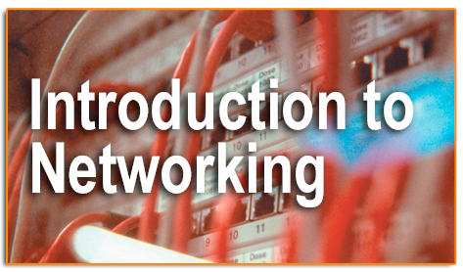
Introducing Basic Network Concepts

Slide 2
Overview
Introduction to networks.
Need for networks.
Classification of networks.

Slide 3
Introduction to Networks
A network consists of two or more entities or objects sharing resources and information.
A computer network consists of two or more computing devices connected to each other to share resources and information.
The network becomes a powerful tool when computers communicate and share resources with other computers on the same network or entirely distinct networks.

Slide 4
Introduction to Networks
Computers on a network can act as a client or a server.
A client is a computer that requests for resources.
A server is a computer that controls and provides access to resources.

Slide 5
Introduction to Networks
Data is a piece of information.
The computing concept ‘hierarchy of data’ is used when planning a network.
It is essential to maintain a hierarchy of data to manage and control resources among computers.
Network access to data must be evaluated carefully to avoid security issues.

Slide 6
Need for Networks
A computer that operates independently from other computers is called a stand-alone computer.
The process of printing or transferring data from one system to another using various storage devices is called sneakernet.

Slide 7
Need for Networks
Enhance communication.
Share resources.
Facilitate centralized management.

Slide 8
Enhance Communication
Computer networks use electronic mail (e-mail) as the choice for most of the communication.
By using networks, information can be sent to a larger audience in an extremely fast and efficient manner.

Slide 9
Share Resources
A copy of data or application stored at a single central location is shared over a network.
Computer peripheral devices, referred to as additional components, can be attached to a computer and be shared in a network.

Slide 10
Share Resources
Peripheral devices include faxes, modems, scanners, plotters, and any other device that connects to the computers.
Equipments having common requirements can be shared in order to reduce maintenance cost.

Slide 11
Share Resources
Important data can also be stored centrally to make it accessible to users, thereby saving storage space on individual computers.
Computer applications, which take up a considerable amount of storage space, can be installed centrally on the network, saving storage space.

Slide 12
Facilitate Centralized Management
Networks are used to assist in management tasks associated with their own operation and maintenance.
Using networks results in increased efficiency and a resultant reduction in maintenance costs.

Slide 13
Facilitate Centralized Management
Software:
  Software is a set of instructions or programs that control the operation of a computer.
  Software can be installed at a central location using servers, where the installation files are made accessible over the network.

Slide 14
Classification of Networks
Classification by network geography.
Classification by component roles.

Slide 15
Classification by Network
Geography
Networks are frequently classified according to the geographical boundaries spanned by the network itself.
LAN, WAN, and MAN are the basic types of classification, of which LAN and WAN are frequently used.

Slide 16
Classification by Network
Geography
Local area network (LAN):
  A LAN covers a relatively small area such as a classroom, school, or a single building.
  LANs are inexpensive to install and also provide higher speeds.

Slide 17
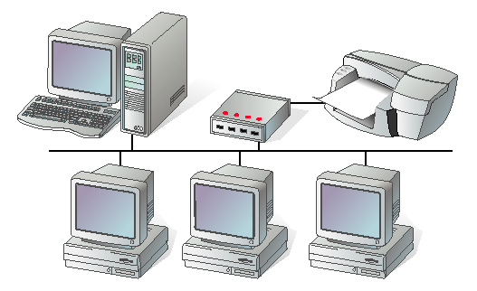
Classification by Network
Geography
Local area network

Slide 18
Classification by Network
Geography
Metropolitan area network (MAN):
  A MAN spans the distance of a typical metropolitan city.
  The cost of installation and operation is higher.
  MANs use high-speed connections such as fiber optics to achieve higher speeds.

Slide 19
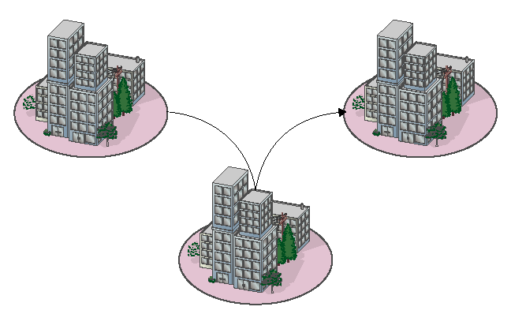
Classification by Network
Geography
Metropolitan area network

Slide 20
Classification by Network
Geography
Wide area network (WAN):
  WANs span a larger area than a single city.
  These use long distance telecommunication networks for connection, thereby increasing the cost.
  The Internet is a good example of a WAN.

Slide 21
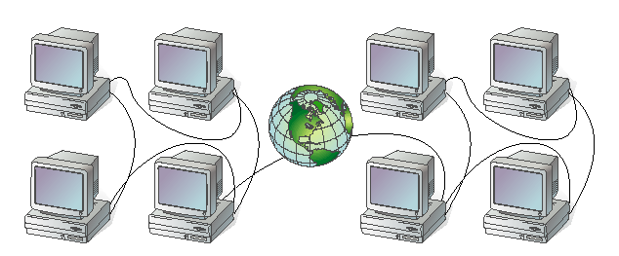
Classification by Network
Geography
Wide area network

Slide 22
Classification by Component Roles
Networks can also be classified according to the roles that the networked computers play in the network’s operation.
Peer-to-peer, server-based, and client-based are the types of roles into which networks are classified.

Slide 23
Classification by Component Roles
Peer-to-peer:
  In a peer-to-peer network, all computers are considered equal.
  Each computer controls its own information and is capable of functioning as either a client or a server depending upon the requirement.
  Peer-to-peer networks are inexpensive and easy to install.
  They are popular as home networks and for use in small companies.

Slide 24
Classification by Component Roles
Peer-to-peer (continued):
  Most operating systems come with built-in peer-to-peer networking capability.
  The maximum number of peers that can operate on a peer-to-peer network is ten.
  Each peer shares resources and allows others open access to them.

Slide 25
Classification by Component Roles
Peer-to-peer (continued):
  Peer-to-peer networks become difficult to manage when more security is added to resources, since the users control their security by password-protecting shares.
  Shares can be document folders, printers, peripherals, and any other resource that they control on their computers.

Slide 26
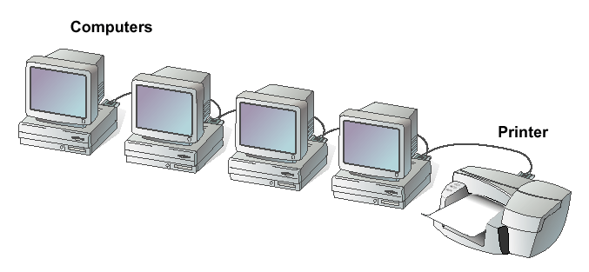
Classification by Component Roles
Peer-to-peer network

Slide 27
Classification by Component Roles
Server-based:
  A server-based network offers centralized control and is designed for secure operations.
  In a server-based network, a dedicated server controls the network.

Slide 28
Classification by Component Roles
Server-based (continued):
  A dedicated server is one that services the network by storing data, applications, resources, and also provides access to resources required by the client.
  These servers can also control the network’s security from one centralized location or share it with other specially configured servers.

Slide 29
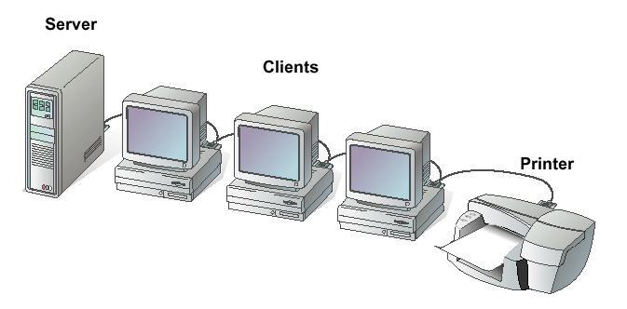
Classification by Component Roles
Server-based network

Slide 30
Classification by Component Roles
Client-based:
  Client-based network servers process requests from clients and return just the results.
  These networks take advantage of the powerful processing capabilities of both the client and the server.
  Application servers and communications servers are examples of client-based networks.

Slide 31
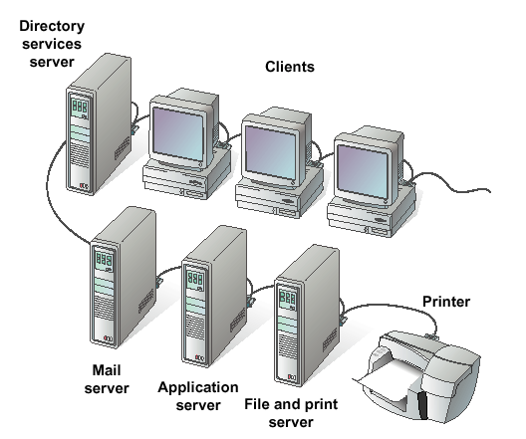
Classification by Component Roles
Client-based network

Slide 32
Summary
A network consists of two or more entities sharing resources and information.
A computer network consists of two or more computers that are connected and are able to communicate.

Slide 33
Summary
The basic purpose of networks is to enable effective communication, share resources, and facilitate centralized management of data.
Networks can be classified according to their geographical boundaries or their component roles.

